Slide 1
Reflections on Proj 3
Project 3:
Interesting watch about why MIT stopped teaching the old school “pure” programming class (similar to your experience in 61A filling in functions) vs. the kludgier tool-heavy projects of 61B: http://www.posteriorscience.net/?p=206
“Sussman said that in the 80s and 90s, engineers built complex systems by combining simple and well-understood parts. The goal of SICP was to provide the abstraction language for reasoning about such systems.”
“Today, this is no longer the case. Sussman pointed out that engineers now routinely write code for complicated hardware that they don’t fully understand (and often can’t understand because of trade secrecy.)”
“Programming today is “More like science. You grab this piece of library and you poke at it. You write programs that poke it and see what it does. And you say, ‘Can I tweak it to do the thing I want?'”

Slide 2
Announcements
Project 3 due Wednesday.
24 hour grace period for the first 24 hours.
5/12ths percent per hour after that.
HW5 released Wednesday: Seam Carving
Roughly the size of Percolation (HW2).
Due next Wednesday.
Today’s lecture a little less dense than usual given proj3 due date.

Slide 3
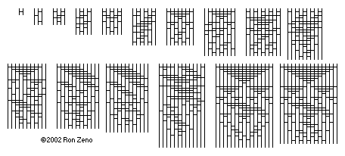
CS61B
Lecture 35: Sorting IV
Sorting Summary
Math Problems out of Nowhere
Theoretical Bounds on Sorting
Notes:
http://www.constructionphotography.com/ImageThumbs/A168-02831/3/A168-02831_plastic_bottles_sorted_by_colour_compressed_into_bales_and_ready_for_recycling.jpg

Slide 4
Sorting
Sorting is a foundational problem.
Obviously useful for putting things in order.
But can also be used to solve other tasks, sometimes in non-trivial ways.
Sorting improves duplicate finding from a naive N² to N log N.
Sorting improves 3SUM from a naive N³ to N².
There are many ways to sort an array, each with its own interesting tradeoffs and algorithmic features.
Today we’ll discuss the fundamental nature of the sorting problem itself: How hard is it to sort?

Slide 5
Sorts Summary
 | Memory | # Compares | Notes | Stable?
Heapsort | Θ(1) | Θ(N log N) | Bad caching (61C) | No
Insertion | Θ(1) | Θ(N²) | Best for almost sorted and N < 15 | Yes
Mergesort | Θ(N) | Θ(N log N) | Fastest stable sort | Yes
Quicksort LTHS | Θ(log N) | Θ(N log N) expected | Fastest sort | No
This is due to the cost of tracking recursive calls by the computer, and is also an “expected” amount. The difference between log N and constant memory is trivial.
You can create a stable Quicksort. However, using unstable partitioning schemes (like Hoare partitioning) and using randomness to avoid bad pivots tend to yield better runtimes.

Slide 6
Math Problems out of Nowhere

Slide 7
A Math Problem out of Nowhere
Consider the functions N! and (N/2)^{N/2}
Is N! ∈ Ω((N/2)^{N/2})? Prove your answer.
Recall that ∈ Ω can be informally be interpreted to mean ≥

Slide 8
A Math Problem out of Nowhere
Consider the functions N! and (N/2)^{N/2}
Is N! ∈ Ω((N/2)^{N/2})? Prove your answer.
10!
10 * 9 * 8 * 7 * 6 * … * 1
5⁵
5 * 5 * 5 * 5 * 5
N! > (N/2)^{N/2}, for large N, therefore N! ∈ Ω((N/2)^{N/2})

Slide 9
Another Math Problem
Given: N! > (N/2)^{N/2}, which we used to prove our answer to the previous problem.
Show that log(N!) ∈ Ω(N log N).
Recall: log means an unspecified base.

Slide 10
Another Math Problem
Given that N! > (N/2)^{N/2}
Show that log(N!) ∈ Ω(N log N).
We have that N! > (N/2)^{N/2}
Taking the log of both sides, we have that log(N!) > log((N/2)^{N/2}).
Bringing down the exponent we have that log(N!) > N/2 log(N/2).
Discarding the unnecessary constant, we have log(N!) ∈ Ω(N log (N/2)).
From there, we have that log(N!) ∈ Ω(N log N).
Since log(N/2) is the same thing asymptotically as log(N).
In other words, log(N!) grows at least as quickly as N log N.

Slide 11
Last Math Problem
In the previous problem, we showed that log(N!) ∈ Ω(N log N).
Now show that N log N ∈ Ω(log(N!)).

Slide 12
Last Math Problem
Show that N log N ∈ Ω(log(N!))
Proof:
log(N!) = log(N) + log(N-1) + log(N-2) + …. + log(1)
N log N = log(N) + log(N) + log(N) + … log(N)
Therefore N log N ∈ Ω(log(N!))

Slide 13
Omega and Theta: yellkey.com/quickly
Given:
N log N ∈ Ω(log(N!))
log(N!) ∈ Ω(N log N)
Which of the following can we say?
N log N ∈ Θ(log N!)
log N! ∈ Θ(N log N)
Both A and B
Neither

Slide 14
Omega and Theta
Given:
N log N ∈ Ω(log(N!))
log(N!) ∈ Ω(N log N)
Which of the following can we say?
N log N ∈ Θ(log N!)
log N! ∈ Θ(N log N)
Both A and B
Neither
Informally: N log N ≥ log(N!)
Informally: log(N!) ≥ N log N
Informally: N log N = log(N!)

Slide 15
Summary
We’ve shown that log(N!) ∈ Θ(N log N).
In other words, these two functions grow at the same rate asymptotically.
As for why we did this, we will see in a little while...

Slide 16
Theoretical Bounds on Sorting

Slide 17
Sorting
We have shown several sorts to require Θ(N log N) worst case time.
Can we build a better sorting algorithm?
Let the ultimate comparison sort (TUCS) be the asymptotically fastest possible comparison sorting algorithm, possibly yet to be discovered, and let R(N) be its worst case runtime.
Give the best Ω and O bounds you can for R(N).
It might seem strange to give Ω and O bounds for an algorithm whose details are completely unknown, but you can, I promise!
By comparison sort, I mean that it uses e.g. the compareTo method in Java to make decisions.

Slide 18
Sorting
We have shown several sorts to require Θ(N log N) worst case time.
Can we build a better sorting algorithm?
Let the ultimate comparison sort (TUCS) be the asymptotically fastest possible comparison sorting algorithm, possibly yet to be discovered, and let R(N) be its worst case runtime.
By comparison sort, I mean that it uses e.g. the compareTo method in Java to make decisions.
O(N log N)
Worst case run-time of TUCS, R(N) is O(N log N).
Obvious: Mergesort is Θ(N log N) so R(N) can’t be worse!
Worst case run-time of TUCS, R(N) is Ω(1).
Obvious: Problem doesn’t get easier with N.
Can we make a stronger statement than Ω(1)?
Ω(1)
TUCS Worst
Case Θ Runtime

Slide 19
Sorting
Let TUCS be the asymptotically fastest possible comparison sorting algorithm, possibly yet to be discovered.
Worst case run-time of TUCS, R(N) is O(N log N). Why?
Worst case run-time of TUCS, R(N) is also Ω(N).
Have to at least look at every item.
O(N log N)
Ω(N)
TUCS Worst
Case Θ Runtime

Slide 20
Sorting
We know that TUCS “lives” between N and N log N.
Worst case asymptotic runtime of TUCS is between Θ(N) and Θ(N log N).
Can we make an even stronger statement on the lower bound?
With a clever argument, yes (as we’ll see soon see).
Spoiler alert: It will turn out to be Ω(N log N)
This lower bound means that across the infinite space of all possible ideas that any human might ever have for sorting using sequential comparisons, NONE has a worst case runtime that is better than Θ(N log N).
O(N log N)
Ω(N)
TUCS Worst
Case Θ Runtime

Slide 21
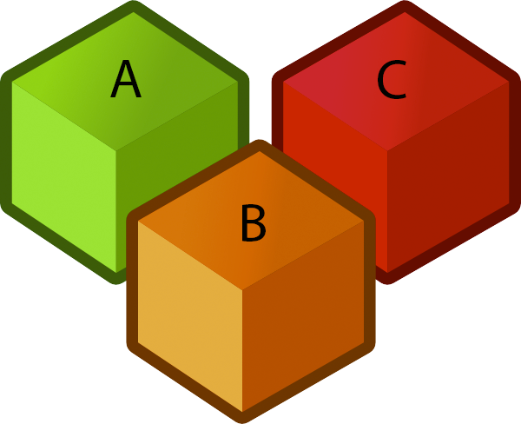


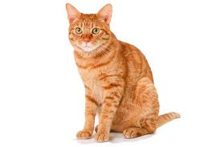

The Game of Puppy, Cat, Dog
Suppose we have a puppy, a cat, and a dog, each in an opaque soundproof box labeled A, B, and C. We want to figure out which is which using a scale.

Slide 22
The Game of Puppy, Cat, Dog
Suppose we have a puppy, a cat, and a dog, each in an opaque soundproof box labeled A, B, and C. We want to figure out which is which using a scale.
a < b | b < c |  | Which is which?
Yes | Yes

Slide 23
The Game of Puppy, Cat, Dog
Suppose we have a puppy, a cat, and a dog, each in an opaque soundproof box labeled A, B, and C. We want to figure out which is which using a scale.
a < b | b < c |  | Which is which?
Yes | Yes |  | a: puppy, b: cat, c: dog (sorted order: abc)
No | No

Slide 24
The Game of Puppy, Cat, Dog
Suppose we have a puppy, a cat, and a dog, each in an opaque soundproof box labeled A, B, and C. We want to figure out which is which using a scale.
a < b | b < c |  | Which is which?
Yes | Yes |  | a: puppy, b: cat, c: dog (sorted order: abc)
No | No |  | c: puppy, b: cat, a: dog (sorted order: cba)

Slide 25
The Game of Puppy, Cat, Dog: http://yellkey.com/arm
Suppose we have a puppy, a cat, and a dog, each in an opaque soundproof box labeled A, B, and C. We want to figure out which is which using a scale.
Which is which?
a: puppy, b: cat, c: dog (sorted order: abc)
a: puppy, c: cat, b: dog (sorted order: acb)
c: puppy, a: cat, b: dog (sorted order: cab)
c: puppy, b: cat, a: dog (sorted order: cba)
a < b | b < c |  | Which is which?
Yes | Yes |  | a: puppy, b: cat, c: dog (sorted order: abc)
No | No |  | c: puppy, b: cat, a: dog (sorted order: cba)
Yes | No

Slide 26
The Game of Puppy, Cat, Dog
Suppose we have a puppy, a cat, and a dog, each in an opaque soundproof box labeled A, B, and C. We want to figure out which is which using a scale.
Which is which? How do we resolve the ambiguity?
a: puppy, b: cat, c: dog (sorted order: abc)
a: puppy, c: cat, b: dog (sorted order: acb)
c: puppy, a: cat, b: dog (sorted order: cab)
c: puppy, b: cat, a: dog (sorted order: cba)
a < b | b < c |  | Which is which?
Yes | Yes |  | a: puppy, b: cat, c: dog (sorted order: abc)
No | No |  | c: puppy, b: cat, a: dog (sorted order: cba)
Yes | No
a? c? b
c? a? b

Slide 27
The Game of Puppy, Cat, Dog
Suppose we have a puppy, a cat, and a dog, each in an opaque soundproof box labeled A, B, and C. We want to figure out which is which using a scale.
Which is which? How do we resolve the ambiguity? Ask if a < c.
a: puppy, b: cat, c: dog (sorted order: abc)
a: puppy, c: cat, b: dog (sorted order: acb)
c: puppy, a: cat, b: dog (sorted order: cab)
c: puppy, b: cat, a: dog (sorted order: cba)
a < b | b < c | a < c? | Which is which?
Yes | Yes | N/A | a: puppy, b: cat, c: dog (sorted order: abc)
No | No | N/A | c: puppy, b: cat, a: dog (sorted order: cba)
Yes | No | Yes | a: puppy, c: cat, b: dog (sorted order: acb)

Slide 28
Puppy, Cat, Dog - A Graphical Picture for N = 3
The full decision tree for puppy, cat, dog:
Is a < b?
No
Yes
Is a < c?
Is b < c?
No
Yes
No
Yes
a: puppy
b: cat
c: dog
Is b < c?
b a c
Is a < c?
a b c
No
Yes
No
Yes
c: puppy
a: cat
b: dog
a: puppy
c: cat
b: dog
c b a
b c a
c a b
a c b

Slide 29
The Game of Puppy, Cat, Dog, yellkey.com/year
How many questions would you need to ask to definitely solve the “puppy, cat, dog, walrus” problem?
3
4
5
6

Slide 30
The Game of Puppy, Cat, Dog
How many questions would you need to ask to definitely solve the “puppy, cat, dog, walrus” problem?
3
4
5
6
Proof:
If N=4, how many permutations? 4! = 24
For N=3: 3!=6
So we need a binary tree with 24 leaves.
How many levels minimum? lg(24) = 4.58, so 5 is the minimum.
lg just means log₂ (log base 2)

Slide 31
Generalized Puppy, Cat, Dog
How many questions would you need to ask to definitely solve the generalized “puppy, cat, dog” problem for N items?
Give your answer in big Omega notation.
Hint: For N=4, we said the answer was 5 based on the following argument:
Decision tree needs 4! = 24 leaves.
So we need lg(24) rounded up levels or 5.

Slide 32
Generalized Puppy, Cat, Dog
How many questions would you need to ask to definitely solve the generalized “puppy, cat, dog” problem for N items?
Answer: Ω(log(N!))
Hint: For N, we have the following argument:
Decision tree needs N! leaves.
So we need lg(N!) rounded up levels, which is Ω(log(N!))

Slide 33
Generalizing Puppy, Cat, Dog
Finding an optimal decision tree for the generalized version of puppy, cat, dog (e.g. N=6: puppy, cat, dog, monkey, walrus, elephant) is an open problem in mathematics.
(To my knowledge) Best known trees known for N=1 through 15 and N=22:
For more, see: http://oeis.org/A036604
Deriving a sequence of yes/no questions to identify puppy, cat, dog is hard. An alternate approach to solving the puppy, cat, dog problem:
Sort the boxes using any generic sorting algorithm.
Leftmost box is puppy.
Middle box is cat.
Right box is dog.

Slide 34
Sorting, Puppies, Cats, and Dogs
Why do we care about these (no doubt adorable) critters?
A solution to the sorting problem also provides a solution to puppy, cat, dog.
In other words, puppy, cat, dog reduces to sorting.
Thus, any lower bound on difficulty of puppy, cat, dog must ALSO apply to sorting.
Physics analogy: Climbing a hill with your legs (CAHWYL) is one way to solve the problem of getting up a hill (GUAH).
Any lower bound on energy to GUAH must also apply to CAHWYL.
Example bound: Takes m*g*h energy to climb hill, so using legs to climb the hill takes at least m*g*h energy.

Slide 35
Sorting Lower Bound
We have a lower bound on puppy, cat, dog, namely that it takes Ω(log(N!)) comparisons to solve such a puzzle.
Since sorting with comparisons can be used to solve puppy, cat, dog, then sorting also takes Ω(log(N!)) comparisons.
Or in other words:
Any sorting algorithm using comparisons, no matter how clever, must use at least k = lg(N!) compares to find the correct permutation. So even TUCS takes at least lg(N!) comparisons.
lg(N!) is trivially Ω(log(N!)), so TUCS must take Ω(log(N!)) time.
So, how does log(N!) compare to N log N?
O(N log N)
Ω(log(N!))
TUCS Worst
Case Θ Runtime

Slide 36
Another Math Problem
Earlier, we showed that log(N!) ∈ Ω(N log N) using the proof below.
In other words, log(N!) grows at least as quickly as N log N.
We have that N! ≥ (N/2)^{N/2}
Taking the log of both sides, we have that log(N!) ≥ log((N/2)^{N/2}).
Bringing down the exponent we have that log(N!) ≥ N/2 log(N/2).
Discarding unnecessary constants, we have log(N!) ∈ Ω(N log N)
Recall that changing base is just multiplying by a constant.

Slide 37
The Sorting Lower Bound (Finally)
Since TUCS is Ω(lg N!) and lg N! is Ω(N log N), we have that TUCS is Ω(N log N).
Any comparison based sort requires at least order N log N comparisons.
O(N log N)
Ω(N log N)
TUCS Worst
Case Θ Runtime

Slide 38
The Sorting Lower Bound (Finally)
Since TUCS is Ω(lg N!) and lg N! is Ω(N log N), we have that TUCS is Ω(N log N).
Any comparison based sort requires at least order N log N comparisons.
Proof summary:
Puppy, cat, dog is Ω(lg N!), i.e. requires lg N! comparisons.
TUCS can solve puppy, cat, dog, and thus takes Ω(lg N!) compares.
lg(N!) is Ω(N log N)
This was because N! is Ω(N/2)^{N/2}
Informally: TUCS ≥ puppy, cat, dog ≥ log N! ≥ N log N
O(N log N)
Ω(N log N)
TUCS Worst
Case Θ Runtime

Slide 39
Optimality
 | Memory | # Compares | Notes | Stable?
Heapsort | Θ(1) | Θ(N log N) | Bad caching (61C) | No
Insertion | Θ(1) | Θ(N²) | Best for almost sorted and N < 15 | Yes
Mergesort | Θ(N) | Θ(N log N) | Fastest stable sort | Yes
Quicksort LTHS | Θ(log N) | Θ(N log N) expected | Fastest sort | No
The punchline:
Our best sorts have achieved absolute asymptotic optimality.
Mathematically impossible to sort using fewer comparisons.
Note: Randomized quicksort is only probabilistically optimal, but the probability is extremely high for even modest N. Are you worried about quantum teleportation? Then don’t worry about Quicksort.

Slide 40
Next Time...
Today we proved that any sort that uses comparisons has runtime Ω(N log N).
Next time we’ll discuss how we can sort in Θ(N) time.
Not impossible, just can’t compare anything while we sort!
Have we proven that we can’t find an algorithm whose average case is better than N log N.
Our proof does not apply.

Slide 41
Average Case of Quicksort
We had two little “proofs”:
The X% case, and we showed that even if you land within X% of the edge, runtime is still N log N.
By analogy with BST insertion. Random insertion into a BST is N log N (not proven but mentioned), so Quicksort is also average N log N.
A true proof involves random variables and integrals, isn’t too bad. See Tim Roughgarden’s Algorithms course if curious.

Slide 42
Average Case of Quicksort
How do we sort a stream of items?
Keep in a PQ, though this is a little funny because you have to be able to traverse the PQ in order, which requires destroying it.
Insertion sort is interesting, because the array is always “almost sorted”, but each set of exchanges can take N time, so overall could end up being N^2.
Use a BST. Is a vanilla BST with no self-balancing features safe?
No, could be in sorted or (reverse sorted) or (almost reverse sorted) order.
The stream is infinite, but we can maintain what we’ve so far in sorted order.
Elements coming into the stream are totally random, is vanilla ok?
Yes, for a reasonable definition of “ok”.

Slide 43
Random Qs
Quicksort uses partitioning to put items in order.
Worst case N^2, average case N log N.
Quickselect uses partitioning to find the median.
Worse case N^2, average case N.
For more content like today:
CS70 a little.
CS170 a fair amount (172/174/176).
https://www.coursera.org/specializations/algorithms
https://www.coursera.org/learn/analytic-combinatorics

Slide 44
Random Qs
When you do partitioning such that you STOP on items equal to the pivot, what good is that?
It is just good for ensuring N log N behavior on arrays of almost all duplicates.
This happens because it keeps the pivot somewhere near the middle after partitioning.
When partitioning and you have a greater than array. What order do you put them in?
Any order works.
N*N! = Theta(N!) -- No.
Does there exist hash sort? Next lecture is kinda hashsort.

Slide 45
Random Qs
What is the optimal known quicksort?
It’s the one in Java called dual pivot quicksort.
Notes:
Reminder: This lecture runs slowly.

Slide 46
AMA
Notes:
Reminder

Slide 47
How do we get random numbers?
Record random stuff like noise in the room, gamma rays.
System clock is one -- but one issue is that the granularity is poor (only changes every millisecond) -- often used instead as a random number seed.
Rely on pseudorandomness [actually deterministic]
For example multiplicative overflow.
I will get a dog someday.
Lightbulb no money from the Green Creative people.
Timing things for raster: Weird timing issues in Java.
Different processes competing for resources.
Just in time compilation.

Slide 48
Sounds of Sorting Algorithms
Starts with selection sort: https://www.youtube.com/watch?v=kPRA0W1kECg
Insertion sort: https://www.youtube.com/watch?v=kPRA0W1kECg&t=0m9s
Quicksort: https://www.youtube.com/watch?v=kPRA0W1kECg&t=0m38s
Mergesort: https://www.youtube.com/watch?v=kPRA0W1kECg&t=1m05s
Heapsort: https://www.youtube.com/watch?v=kPRA0W1kECg&t=1m28s
LSD sort: https://www.youtube.com/watch?v=kPRA0W1kECg&t=1m54s
MSD sort: https://www.youtube.com/watch?v=kPRA0W1kECg&t=2m10s
Shell’s sort: https://www.youtube.com/watch?v=kPRA0W1kECg&t=3m37s
Questions to ponder (later… after class):
How many items for selection sort?
Why does insertion sort take longer / more compares than selection sort?
At what time stamp does the first partition complete for Quicksort?
Could the size of the input to mergesort be a power of 2?
What do the colors mean for heapsort?

Slide 49
Sorting Implementations (Extra)

Slide 50
A Note on Implementations
Concrete implementations are nice for solidifying understanding.
Implementing these yourself provides much deeper understanding than just reading my code.
You are not responsible for the details of these specific implementations.
Given enough time, you should be able to implement any of these sorts.

Slide 51
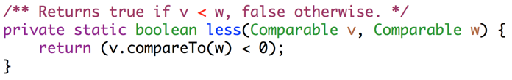
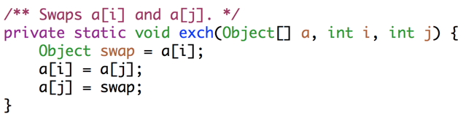
Utility Methods For Sorting

Slide 52
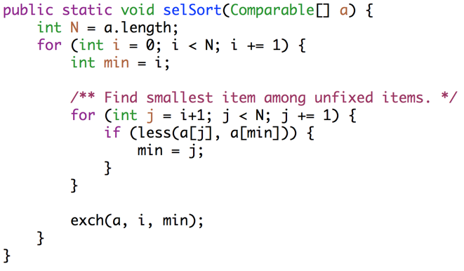
Selection Sort
Key ideas: Among unfixed items, find minimum in Θ(N) time and swap to the front. Subproblem has size N-1. Total runtime is N + N-1 + … + 1 = Θ(N²).

Slide 53
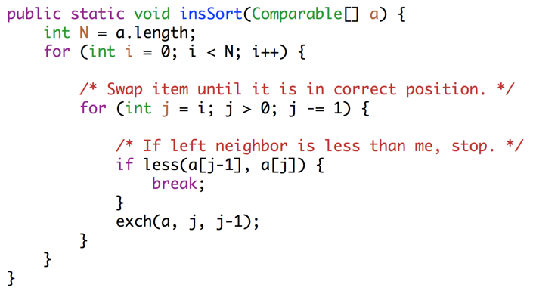
Insertion Sort
Key ideas: For each item (starting at leftmost), swap leftwards until in place. For item k, takes Θ(k) worst case time. Runtime is 1 + 2 + … + N = Θ(N²).

Slide 54
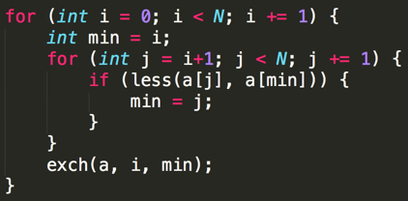
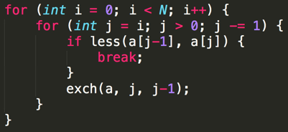
Selection and Insertion Sort Runtimes (Code Analysis)
Selection sort: Runtime is independent of input, always Θ(N²).
~N²/2 compares and ~N²/2 exchanges. Θ(N²) runtime.
Insertion sort: Runtime is strongly dependent on input. Ω(N), O(N²)
Best case (sorted): ~N compares, 0 exchanges: Θ(N)
Worst case (reverse sorted): ~N²/2 compares, ~N²/2 exchanges: Θ(N²)

Slide 55
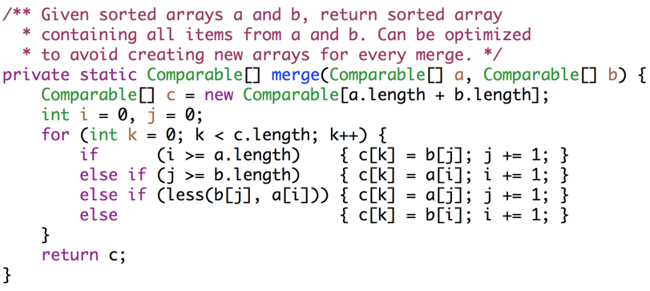
Mergesort (Merge Method)

Slide 56
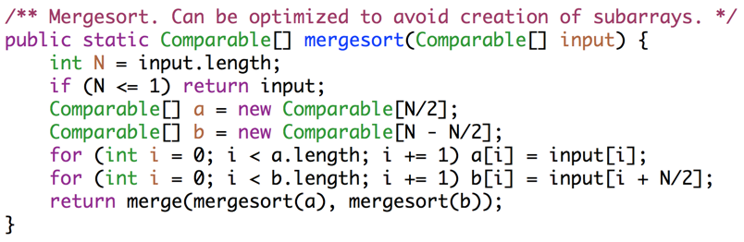
Mergesort
Key ideas: Each merge costs Θ(N) time and Θ(N) space, and generates two subproblems of size N/2. At level L of the sort, there are 2^{L} subproblems of size N/2^{L}. Since L = Θ(log N), runtime is Θ(N log N).

Slide 57
Interview Question
How can the above mergesort implementation be improved?
Try and avoid making copies a and b, by adding parameters to the merge routine. merge(input, 0, 5, 6, 10);
Use a diferent for small N: Like maybe insertion sort. Industrial strength mergesorts, use insertion sort for N < 15.

Slide 58
Interview Question
How can the above mergesort implementation be improved?

Slide 59
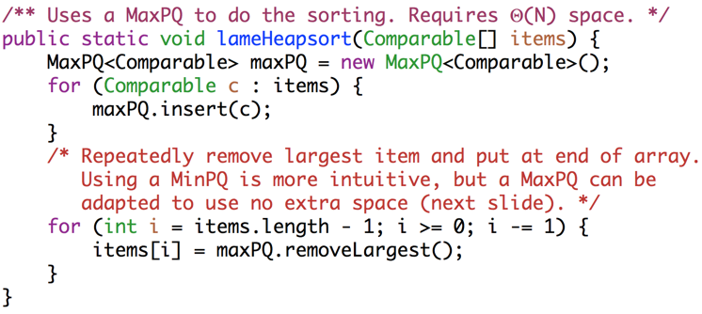
Heapsort With Separate PQ
Key ideas: Create a max heap of all items [Θ(N log N)], then delete max N times [Θ(log N) per delete]. Requires Θ(N) space.

Slide 60
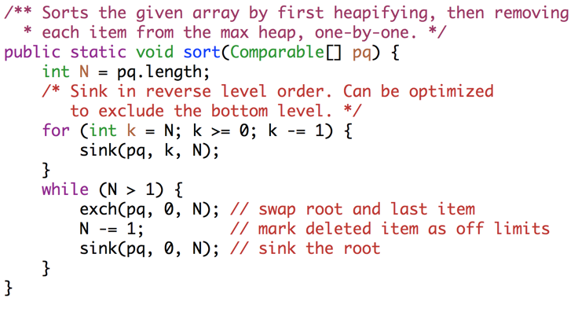
In-Place Heapsort (with root in position 0).
Key ideas: Max-Heapfiy [Θ(N)], then delete max N times [Θ(log N) per delete]

Slide 61
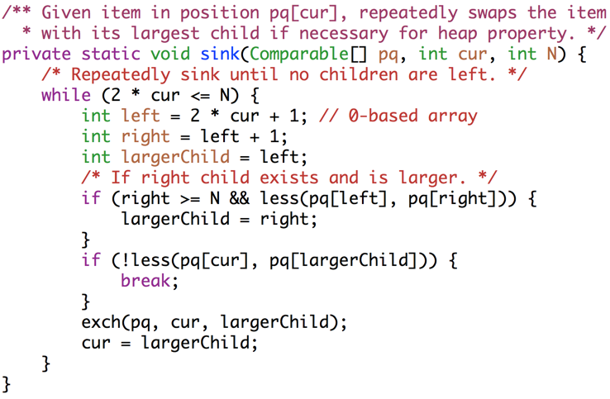
In-Place Heapsort Sink Operation (with root in position 0).

Slide 62
Citations
Title image: http://www.angelfire.com/blog/ronz/Articles/999SortingNetworksReferen.html
Cubes: http://www.clker.com/cliparts/6/9/3/2/1197122947130754155jean_victor_balin_Cubes.svg.hi.png
Scale: http://www.clipartbest.com/cliparts/94T/bAe/94TbAejig.png
Puppy:http://assets.nydailynews.com/polopoly_fs/1.1245686!/img/httpImage/image.jpg_gen/derivatives/article_970/afp-cute-puppy.jpg
Cat: http://animalia-life.com/cat.html
Dog: http://animalia-life.com/dogs.html

